Slide 1
CFD pool fire simulations
UCT PRAGUE
Faculty of Chemical Engineering
Aleš Palkovič
Notes:
Dear all, my name is Aleš. I am in 2nd year of my PHD studies and I am focused on CFD simulations. In my master thesis I have looked into a simulation of water mist suppression in Fluent. A lot of questions about turbulence and chemistry models.

Slide 2
How to properly set up a simulation of a non-premixed combustion in Fluent?
Notes:
Dear all, my name is Aleš. I am in 2nd year of my PHD studies and I am focused on CFD simulations. In my master thesis I have looked into a simulation of water mist suppression in Fluent. A lot of questions about turbulence and chemistry models.

Slide 3
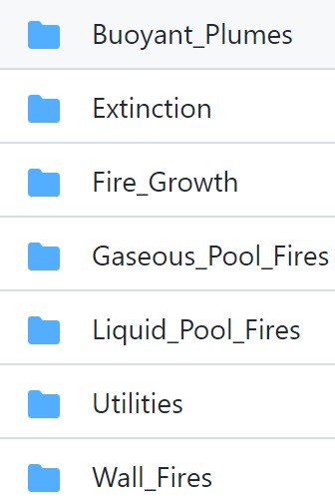
MaCFP
Measurement and Computation of Fire Phenomena
International Association for Fire Safety Science
Systematic development of fire modelling
Database of experimental data
Compare simulation approaches
Generic SW - Ansys Fluent
FDS
OpenFOAM/FireFOAM
In-house codes

Slide 4
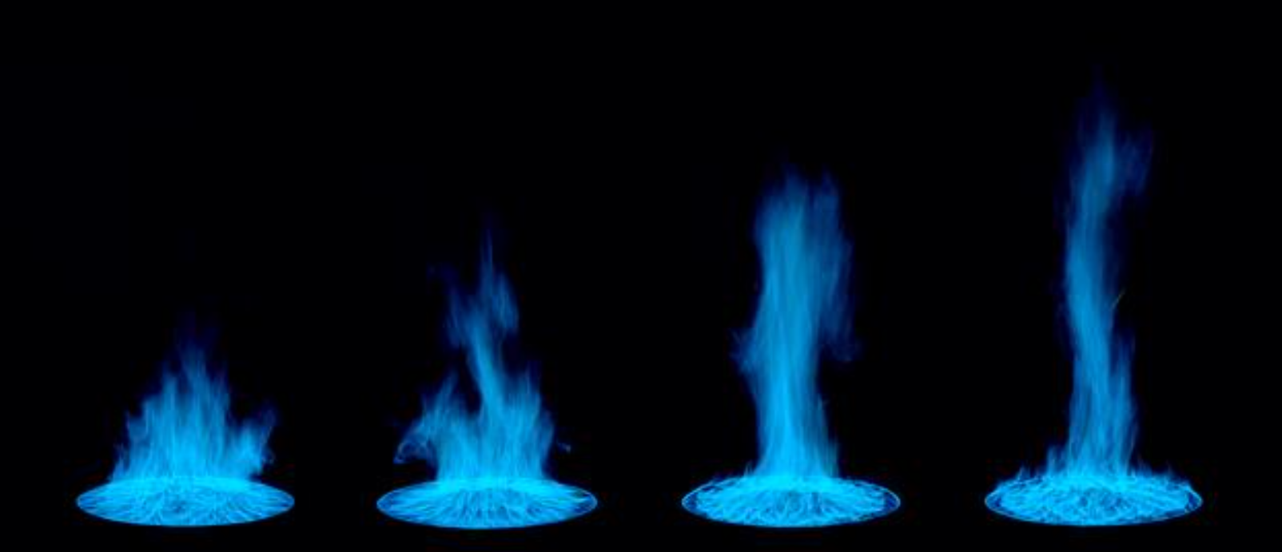
Experiment – methane burner
Freestanding burner
Defined fuel flow rate
measurement
D = 37 cm → D = 5 cm
Falkenstein-Smith, R., K. Sung, J. Chen, and A. Hamins, Chemical Structure of Medium-Scale Liquid Pool Fires, Fire Safety Journal

Slide 5
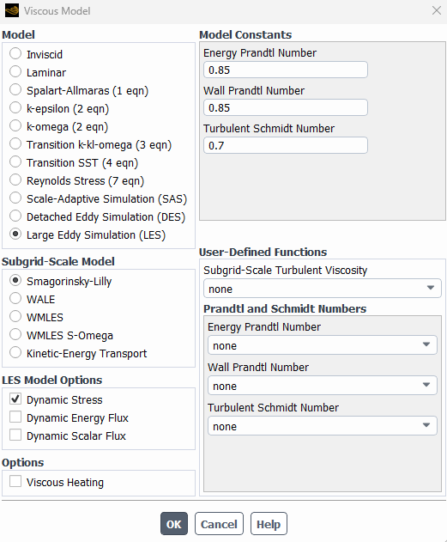
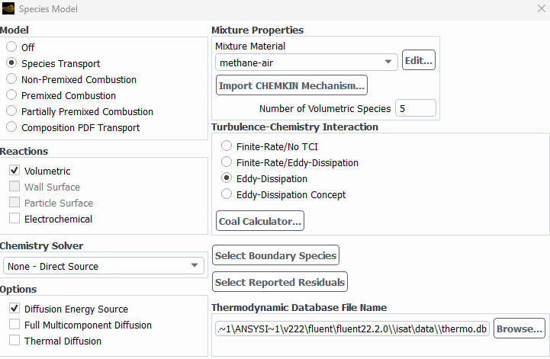
Ansys Fluent
Comertial, widely used in industry
Robust
Turbulence
Reaction

Slide 6
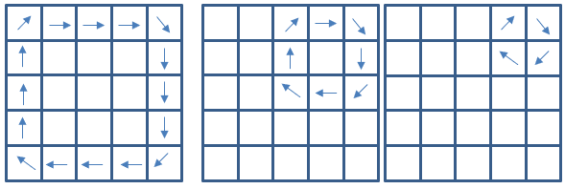
Turbulence + mesh
Fluctuation in time
Eddies
Transport of energy
Mixing
Smallest eddies: 4 cells
Enegy dissipated into heat
Kolmogorov microscale
Energy cascade →

Slide 7
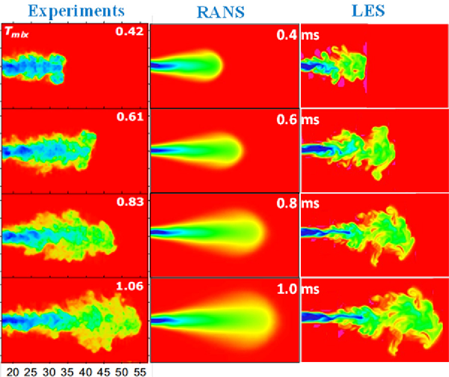
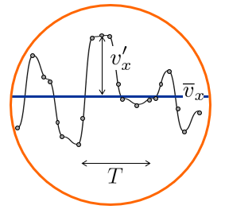
Turbulence
Direct Numerical Simualtion (DNS)
Large Eddy Simulation (LES)
Reynolds Averaged Navier-Stokes (RANS)
Som, S., P. Senecal and E. Pomraning. “Comparison of RANS and LES Turbulence Models against Constant Volume Diesel Experiments.” (2012).
Notes:
Pope – 80% kin. energie

Slide 8
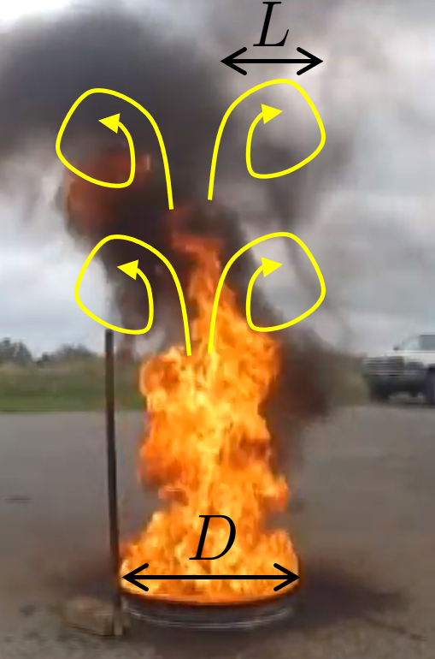
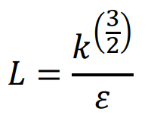
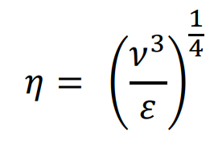
Methane burner – d = 50 mm
 | Estimate | RANS
Integral length scale (L) | 25 mm | 35 mm
Kolmogorov microslale (η) | 0.6 mm | 0.3 mm
Notes:
Kolmogorov

Slide 9
Appropriate cell size?
Recommendations:
L/10 ≈ 2,5 mm (= D/20)
D*/16 ≈ 3,2 mm (fine mesh - FDS)
Mesh sensitivity analysis
Different mesh sizes
Monitoring important quantities
Characteristic fire diameter
Notes:
D*/4 coarse D*/10 medium

Slide 10
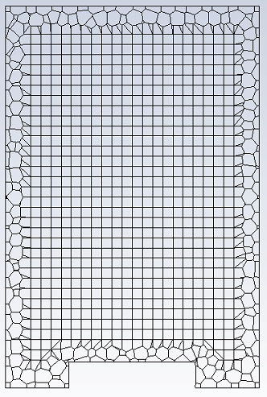
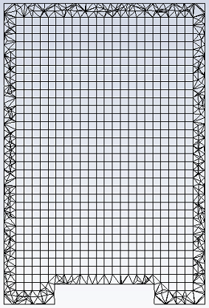
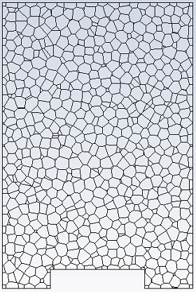
Sensitivity analysis - RANS
Monitoring of HRR, steady state
3 types of meshes (6 mm)
6 mm 4 mm
3 mm
2 mm
1.5 mm
1 mm
2.2 mil
Poly-hexcore
22 000
Hexcore
52 000
Polyhedra
12 000
Notes:
Rychlost vývinu tepla

Slide 11
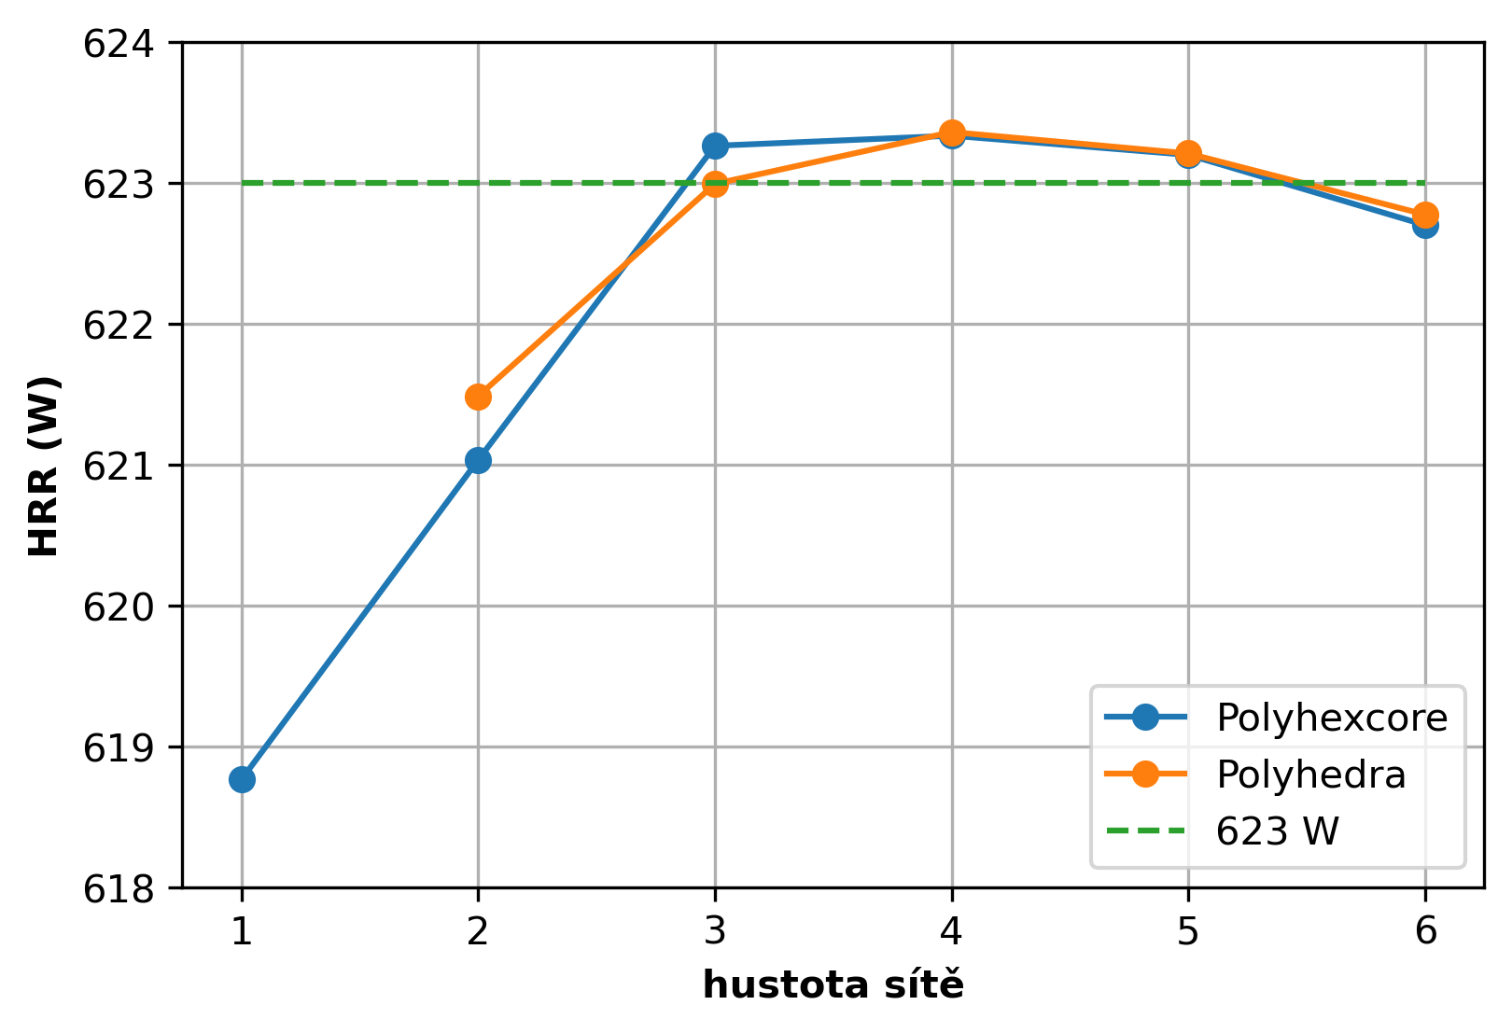
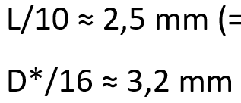
Sensitivity analysis - result
Level of refinement | Cell size (mm)
1 | 6
2 | 4
3 | 3
4 | 2
5 | 1.5
6 | 1
Level of refinement
3 mm - suitable
Hexcore – diverged

Slide 12
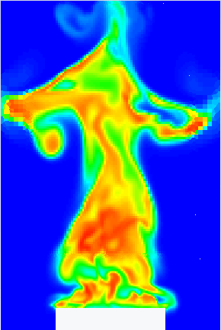
LES
Cell size – 3 mm (89 000 cells)
Transient
Time step – 0.0001 s
Data averaging (10 - 17 s)

Slide 13
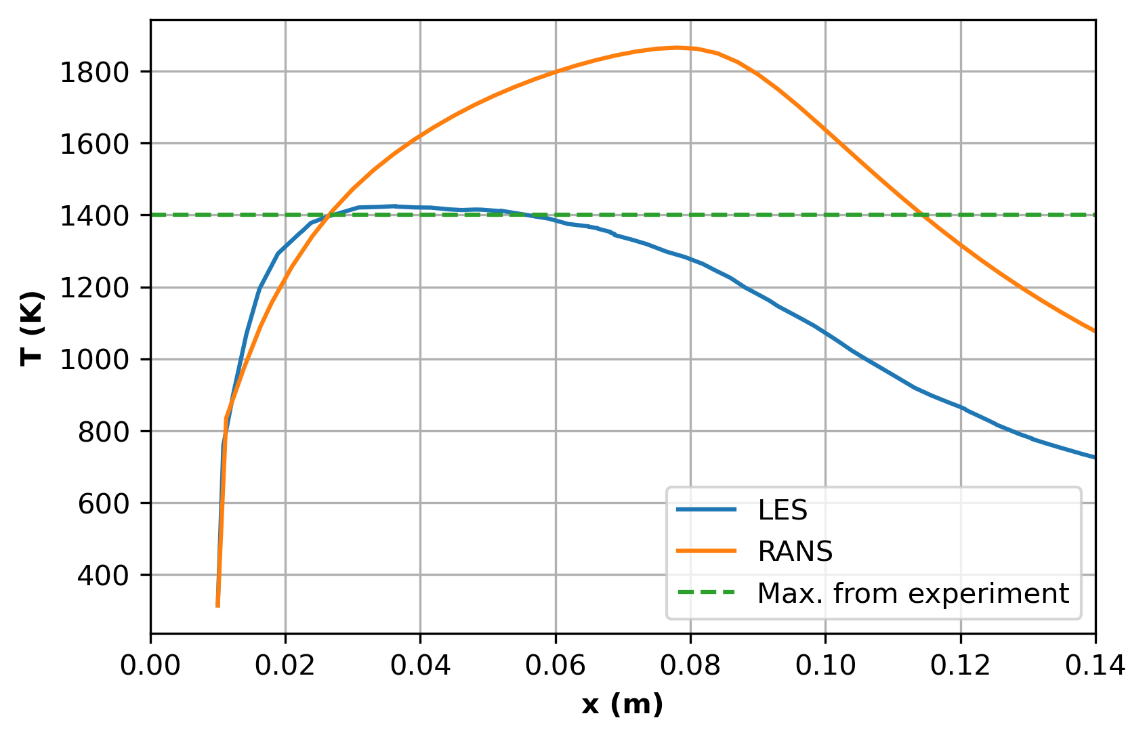
LES – 3 mm, results
Different temperature profile
Average HRR: 623 W
Same as in RANS
Coarse mesh for LES?
RANS overpredicts?

Slide 14
LES – 2 mm, in progress
Cell size – 2 mm (295 000 cells)
Time step – 0.00005 s
Time consuming
Same results as LES 3mm?
RANS overpredicts temperature
LES in Fluent needs more refined mesh

Slide 15
Conclusion and Next steps
Different results from RANS and LES with same mesh
Mesh sensitivity – universal tool for adequate mesh
Scale up to experiment dimensions
Advances meshing methods

Slide 16
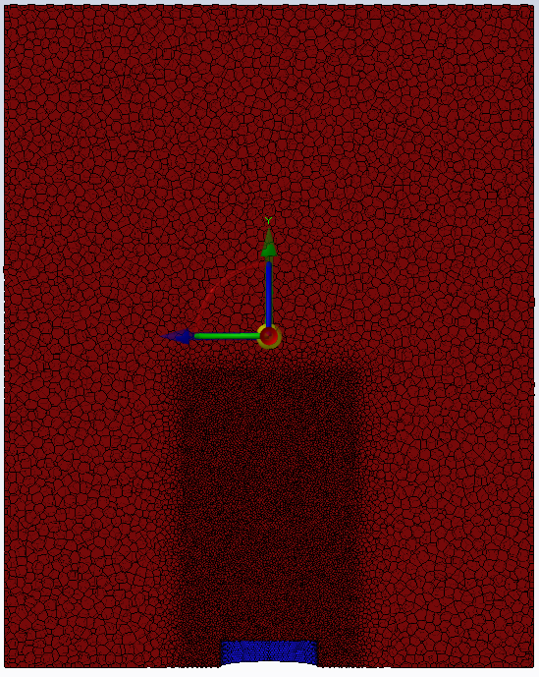
Advanced methods
Body of Influence
Mesh adaptation

Slide 17
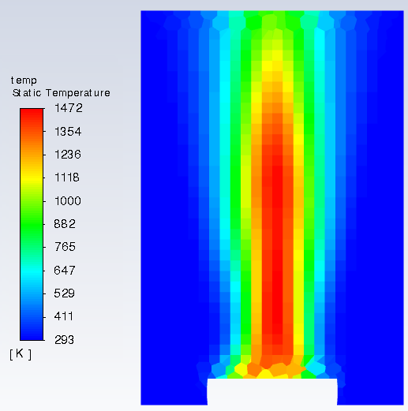
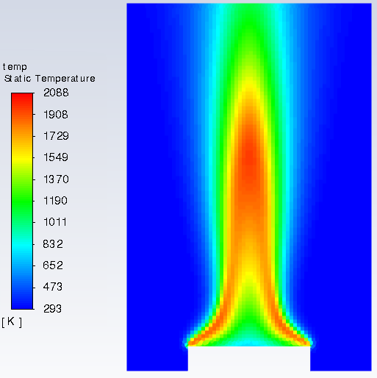
CFD results are as precise…
… as the mesh defined by user.

Slide 18
Thanks

